Slide 1
Lecture Decompose System
Lecturer: Haibin Wang

Slide 2

How to design a complex system?

Slide 3
Topics:
System Decomposition
Design Philosophy

Slide 4
Objectives:
Know what is system design.
Objectives
Know two UML diagrams which are used to describe system design.
Be familiar with different design goals.

Slide 5
Analysis
Design
Implementation
System Design
Design Goal
System Decomposition
Classic Architectures
Distributed Architectures
Object Design
Design Principles1
Design Principles2
From Design
To Implementation
Design Patterns1
Design Patterns2
Design Patterns3
Design Patterns4
Object Design
Database Design
GUI Design
Infrastructure Design
Database Design
GUI
Design
Infrastructure Design
WHERE ARE WE?

Slide 6
System Decomposition

Slide 7
System Design Concepts
Subsystem
A
Package
Service
F
B
Concept
Interface
E
C
System
D
Component
5. SYSTEM DECOMPOSITION

Slide 8
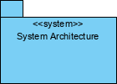
System Decompostion– System
A system is represented as a package with the stereotype of <<system>> as shown in Figure below. The system represents all the model elements that pertain to the particular project.
5. SYSTEM DECOMPOSITION

Slide 9
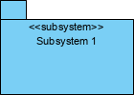
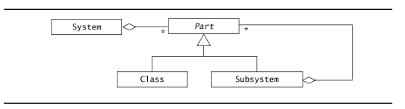
System Decompostion– SubSystem and Classes
A subsystem is a grouping of model elements that are part of the overall system.
Collection of classes, associations, operations, events and constraints that are closely interrelated with each other
The objects and classes from the object model are the “seeds” for the subsystems
In UML subsystems are modeled as packages
5. SYSTEM DECOMPOSITION

Slide 10
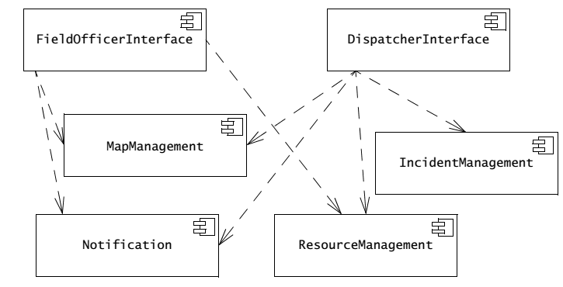
Subsystem - Example
5. SYSTEM DECOMPOSITION

Slide 11
System Decompostion– Services and Interface
A service is a set of related operations that share a common purpose.
Service
A set of named operations that share a common purpose
The origin (“seed”) for services are the use cases from the functional model
Services are defined during system design.
5. SYSTEM DECOMPOSITION

Slide 12
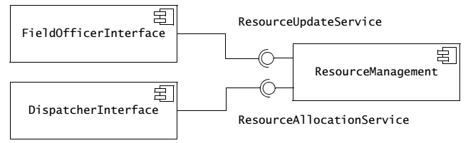
Service Example
Service provided by Notification Subsystem
LookupChannel()
SubscribeToChannel()
SendNotice()
UnscubscribeFromChannel()
5. SYSTEM DECOMPOSITION

Slide 13
Component vs Subsystem vs Package
Component is a physical component that follows a set of interfaces and provides implementation in the system.
A subsystem is a component, usually including many smaller components, which is a large component.
A package is a grouping of elements, which forms a higher-level unit logically. Used to group classes. Similar to namespace, the name is unique in the same package.
5. SYSTEM DECOMPOSITION

Slide 14
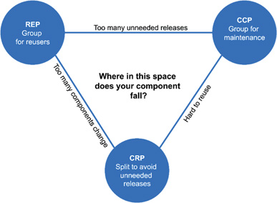
Package Design Principles- Coupling principles
5. SYSTEM DECOMPOSITION

Slide 15
Package Design Principles - REP
The Reuse/Release Equivalence Principle
The unit of reuse is the unit of release.
Effective reuse requires tracking of releases from a change control system.
The package is the effective unit of reuse and release
5. SYSTEM DECOMPOSITION

Slide 16
Package Design Principles - CRP
The Common Reuse Principle
Should not depend on things that you don’t need it.
Classes that are not tightly bound to each other should not be in the same component.
If reuse one class in a package, you should reuse all the classes in the package.
5. SYSTEM DECOMPOSITION

Slide 17
Package Design Principles - CCP
The Common Closure Principle
The classes in a component should be closed together against the same kind of changes.
A change that affects a component affects all the classes in that component and no other components.
Increase maintainability.
5. SYSTEM DECOMPOSITION

Slide 18
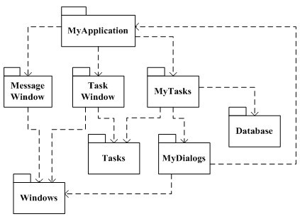
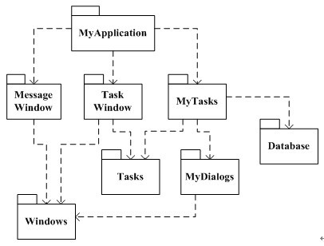
Package Design Principles - ADP
The Acyclic Dependency Principle
Dependency graph of components should have no cycles
5. SYSTEM DECOMPOSITION

Slide 19
Package Design Principles - ADP
Problems
Hard to release editions.
Each release should include all packages.
Hard to isolate other modules.
Hard to know the order of packages to be constructed.
5. SYSTEM DECOMPOSITION

Slide 20
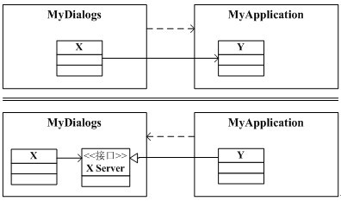
Package Design Principles - ADP
First solution: Dependency reversion
5. SYSTEM DECOMPOSITION

Slide 21
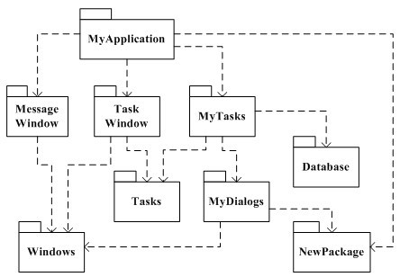
Package Design Principles - ADP
Second solution: Create a new package
5. SYSTEM DECOMPOSITION

Slide 22
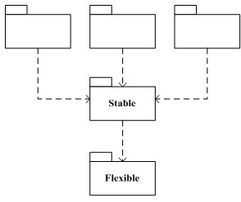
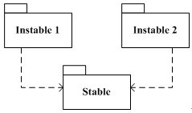
Package Design Principles - SDP
The Stable Dependencies Principle:
Modules that are intended to be easy to change should not be dependent on by modules that are harder to change.
5. SYSTEM DECOMPOSITION

Slide 23
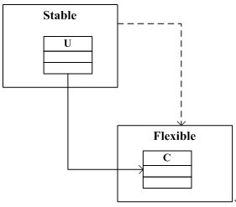
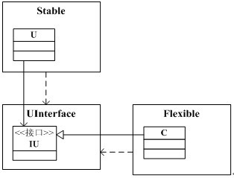
Package Design Principles - SDP
Solution: Relinquish the dependency of Stable on Flexible one.
5. SYSTEM DECOMPOSITION

Slide 24
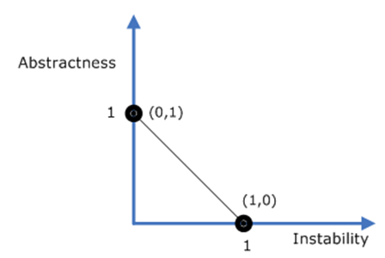
Package Design Principles - SAP
The Stable Abstraction Principle:
A component should be as abstract as it is stable.
Packages that are maximally stable should be maximally abstract. Instable packages should be concrete.
5. SYSTEM DECOMPOSITION

Slide 25
Design Philosophy

Slide 26
Design philosophy
Increasing profit by reducing cost and increasing revenue.
Ensuring that we actually conform to the requirements, thus solving the customers’ problems.
Accelerating development. This helps reduce short-term costs, helps ensure the software reaches the market soon enough to compete effectively, and may be essential to meet some deadline faced by the customer.
Increasing qualities such as usability, efficiency, reliability, maintainability and reusability.
6. SYSTEM DESIGN PRINCIPLES

Slide 27
Divide and conquer
Advantages:
Separate people can work on each part.
Individual engineer can specialize in his or her component, becoming expert at it.
Component is smaller, and easier to understand.
Replaced or changed one component without having to replace or change other parts.
Opportunities arise for making the components reusable.
6. SYSTEM DESIGN PRINCIPLES

Slide 28
Divide and conquer
A software system can be divided in many ways:
A distributed system is divided up into clients and servers.
A system is divided up into subsystems.
A subsystem can be divided up into one or more packages.
A package is composed of classes.
A class is composed of methods.
6. SYSTEM DESIGN PRINCIPLES

Slide 29
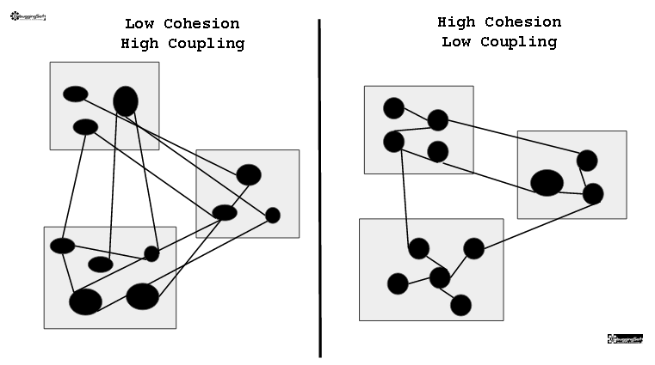
High Cohesion & Low Coupling
Cohesion is the degree to which the elements inside a module belong together.
Coupling is the degree of interdependence between software modules.
6. SYSTEM DESIGN PRINCIPLES

Slide 30
High Cohesion & Low Coupling
Advantages of High Cohesion：
It is easier to make code changes
It is easier to test the code
Better readablity
Advantages of Low Coupling：
Tightly coupled modules are difficult to change.
Tightly coupled modules are also difficult to test.
6. SYSTEM DESIGN PRINCIPLES

Slide 31
High Cohesion & Low Coupling
Several important types of cohesion that designers should try to achieve:
Functional
Layer
Communicational
Sequential
Procedural
Temporal
Utility
Strong
Week
6. SYSTEM DESIGN PRINCIPLES

Slide 32
High Cohesion & Low Coupling
The types of coupling are:
Content
Common
Control
Stamp
Data
Routine call
Type use
Inclusion/import
External
Strong
Week
6. SYSTEM DESIGN PRINCIPLES

Slide 33
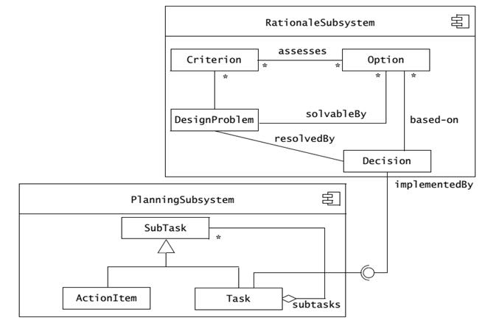
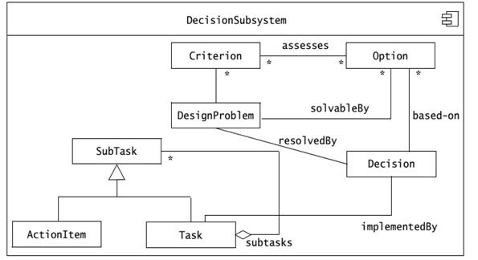
High Cohesion & Low Coupling - Example
6. SYSTEM DESIGN PRINCIPLES

Slide 34
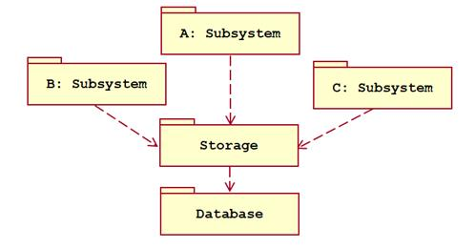
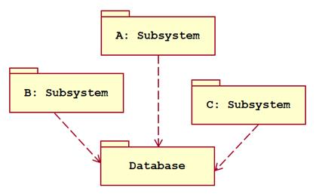

High Cohesion & Low Coupling – Your Turn
6. SYSTEM DESIGN PRINCIPLES

Slide 35
Abstraction Oriented Design
Hide details, thus reducing complexity.
Help you to understand the essence.
By later stage of design.
By the compiler or run-time system.
By the use of default values.
Major Mathods:
Use interface or abstracted class.
Encapsulated variable stuff
6. SYSTEM DESIGN PRINCIPLES

Slide 36

Keep Moderate Design
Do not design insufficiently.
Don't over design.
Be cautious in using new technologies
Don't make wheels again
Do not over optimize
Don't go too far in designing
6. SYSTEM DESIGN PRINCIPLES

Slide 37
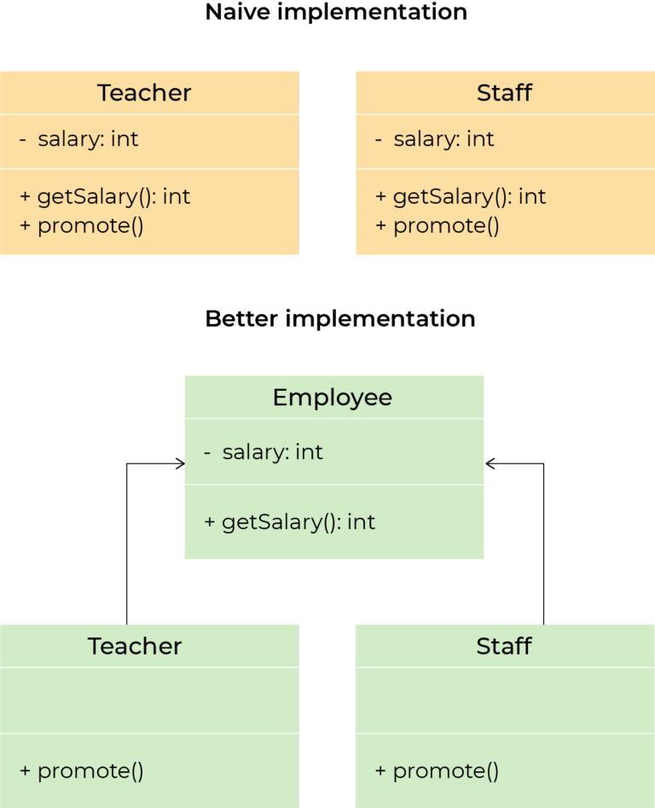
Don’t Repeat Yourself
Every piece of knowledge must have a single, unambiguous, authoritative representation within a system.
Duplication is evil.
Copy paste programming
6. SYSTEM DESIGN PRINCIPLES

Slide 38
Don’t Use Outdated Technology
Avoid using early released technologies.
Avoid using software libraries specific to specific environments.
Avoid using unrecorded or rarely used features in the software library.
Avoid using reusable software or special hardware from smaller companies or companies that are unlikely to provide long-term support.
Using standard languages and technologies supported by multiple suppliers
6. SYSTEM DESIGN PRINCIPLES

Slide 39
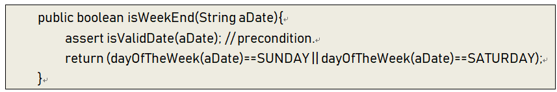
Design defensively
Never trust how others will try to use a component you are designing.
Check all inputs
Design based on contracts.
6. SYSTEM DESIGN PRINCIPLES

Slide 40
Example：From Objects to Subsystems
Crossing: A geographical point where several Segments meet.
Destination: A location where the driver wishes to go.
Direction: Given a Crossing and an adjacent Segment, a Direction describes in natural language how to steer the car onto the given Segment.
Location: A Location is the position of the car as known by the onboard GPS system or the number of turns of the wheels.
PlanningService: A PlanningService is a Web server that can supply a trip, linking a number of destinations in the form of a sequence of Crossings and Segments.
RouteAssistant: A RouteAssistant gives Directions to the driver, given the current Location and upcoming Crossing.
Segment: A Segment represents the road between two Crossings.
Trip: A Trip is a sequence of Directions between two Destinations.

Slide 41
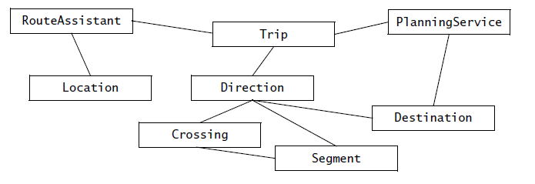
Nonfunctional requirements for MyTrip

Slide 42
Heuristics for grouping objects into subsystems
Assign objects identified in one use case into the same subsystem.
Create a dedicated subsystem for objects used for moving data among subsystems.
Minimize the number of associations crossing subsystem boundaries.
All objects in the same subsystem should be functionally related.

Slide 43
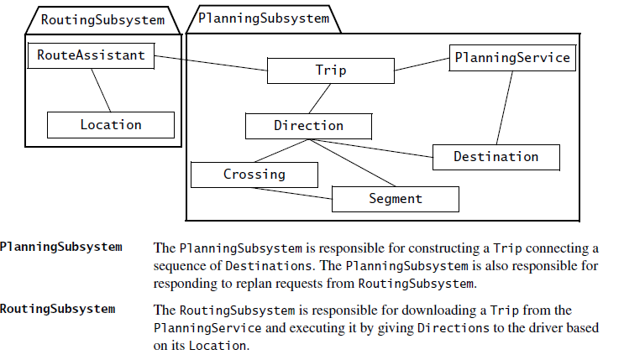
Example：From Objects to Subsystems

Slide 44
Thank You !

